Slide 1
Lecture #2
By: Aqib Rehman

Slide 2
outline
React Dev Tools
DOM Events
Changing State (and 'this')

Slide 3
React Dev Tools
To Interact with components

Slide 4
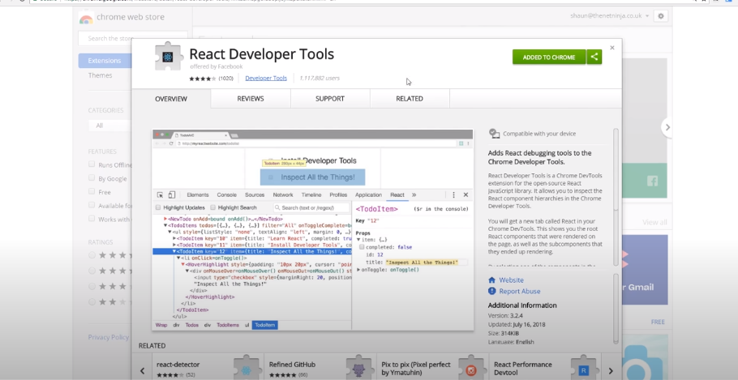
https://chromewebstore.google.com/detail/react-developer-tools/fmkadmapgofadopljbjfkapdkoienihi?hl=en&pli=1

Slide 5
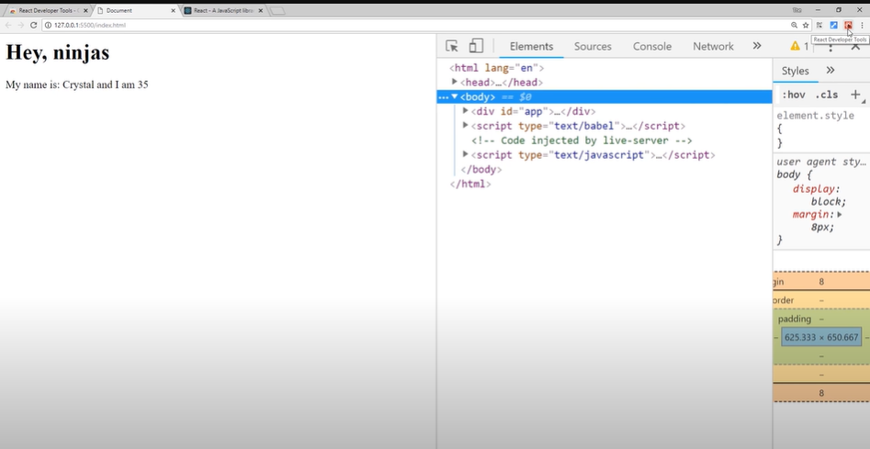

Slide 6
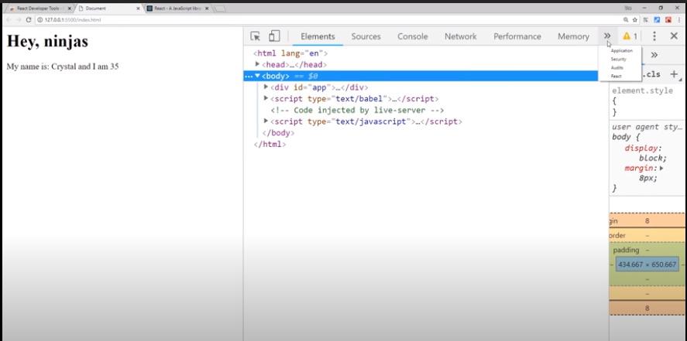

Slide 7
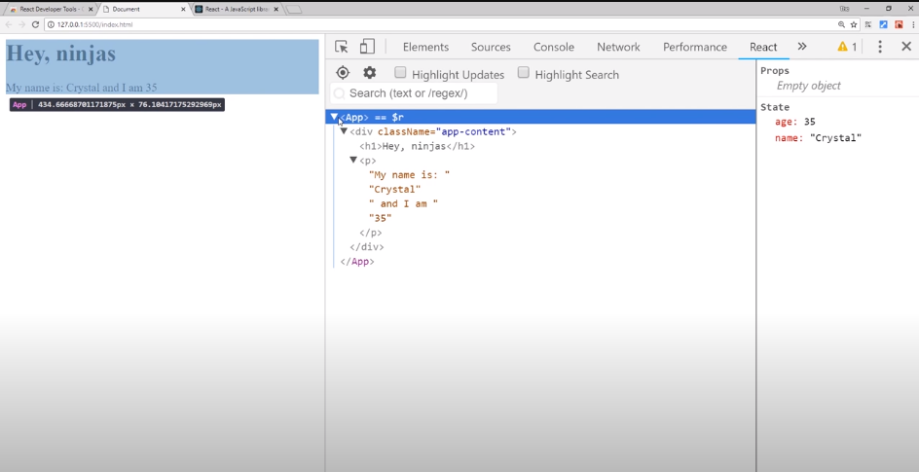

Slide 8
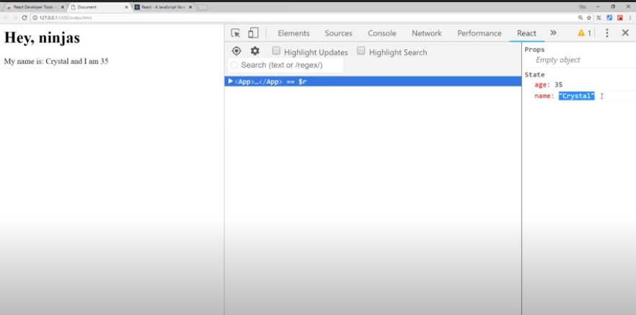

Slide 9
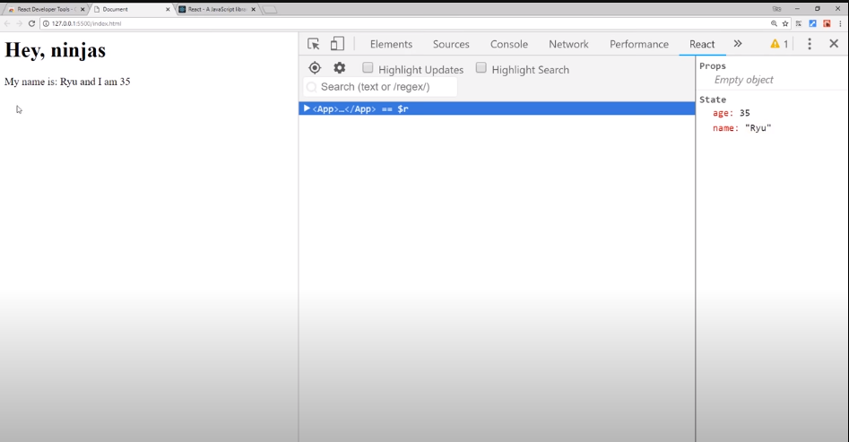

Slide 10
Its not for end user
He/she will not interact with it like this
It is just for you to play around this

Slide 11
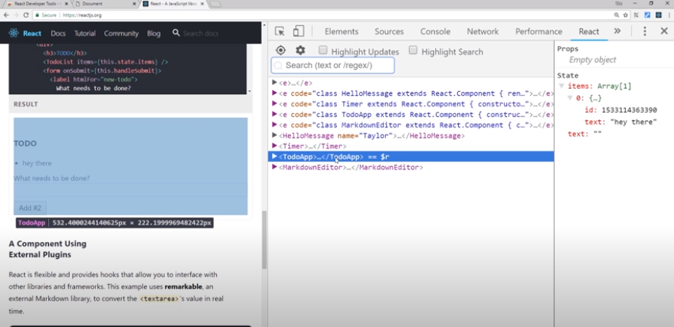
Production version of react
Sign color is black and blue
https://legacy.reactjs.org/

Slide 12
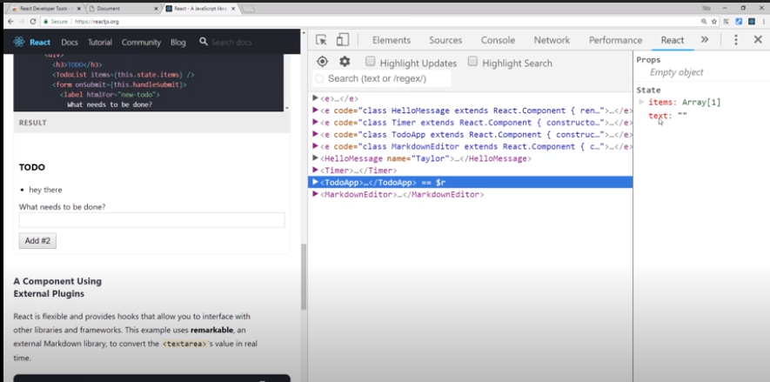

Slide 13
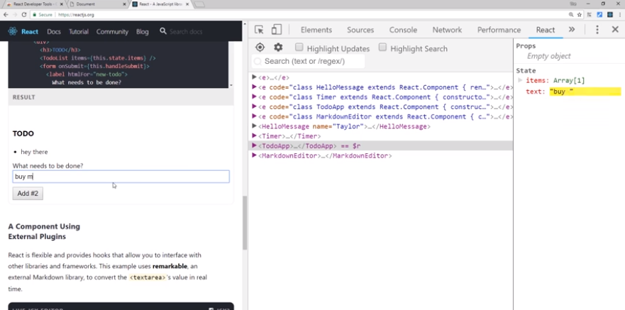

Slide 14
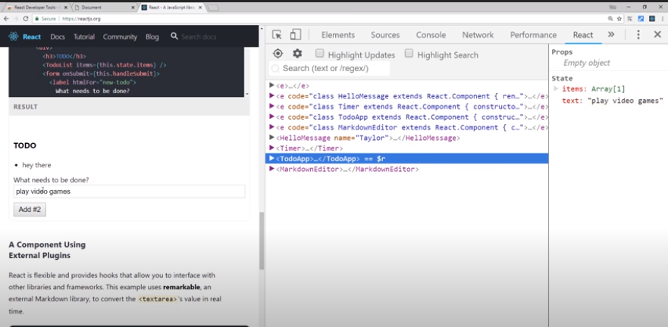
If type on right side states…

Slide 15
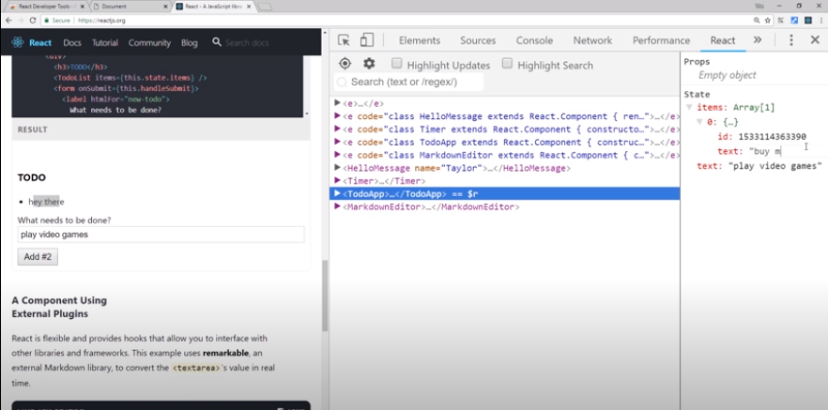

Slide 16
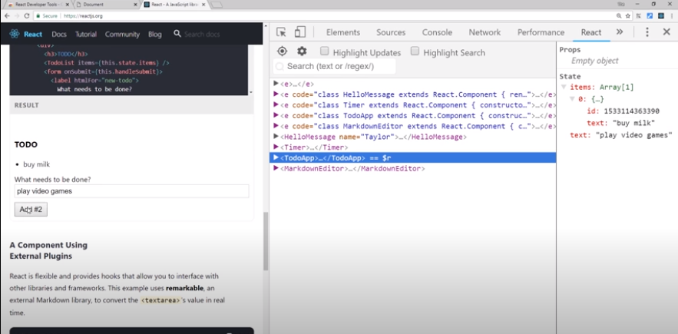
If click on Add #2

Slide 17
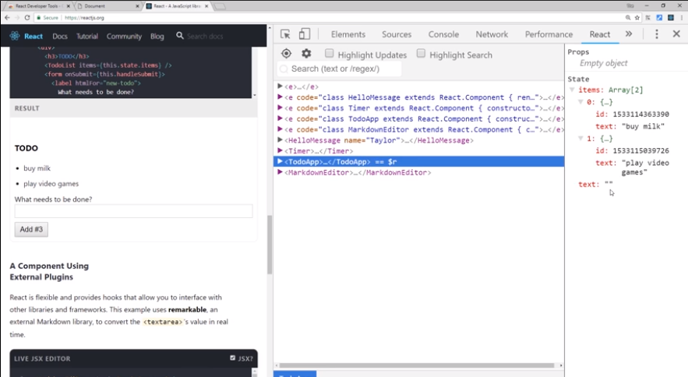

Slide 18
Nice tool for interaction with components

Slide 19
DOM Events

Slide 20
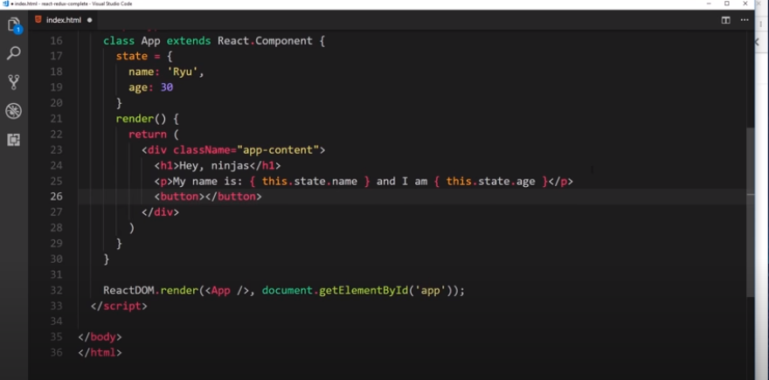

Slide 21
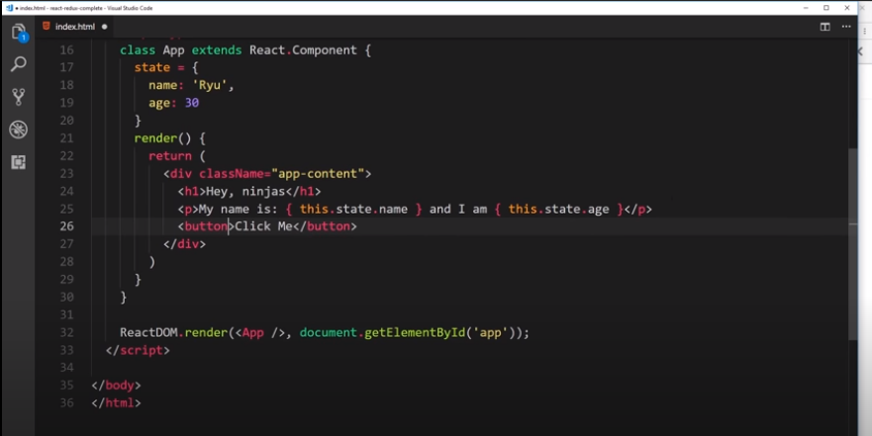

Slide 22
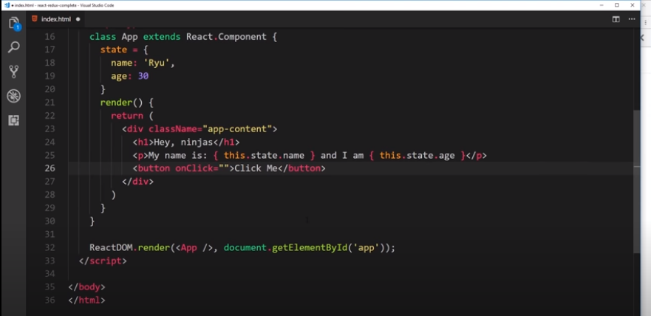
Not write like this

Slide 23
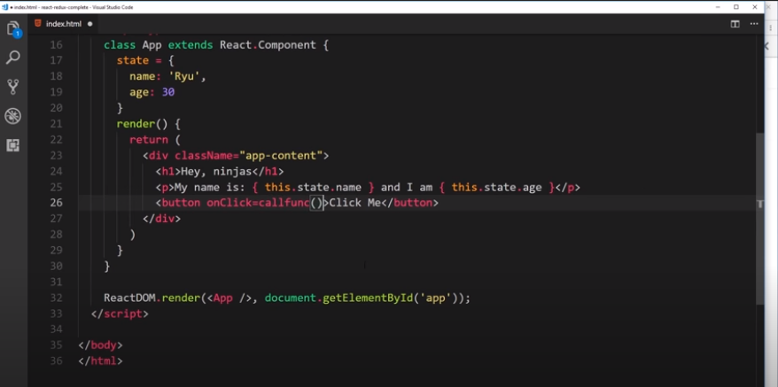
Not write like this

Slide 24
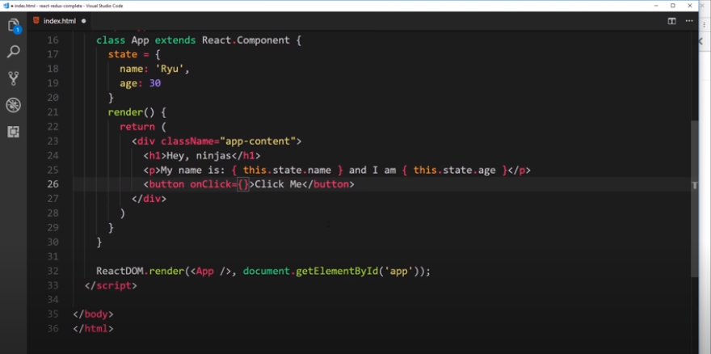

Slide 25
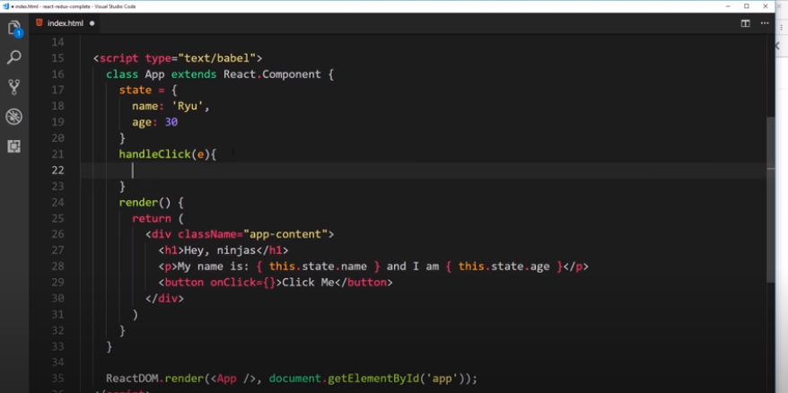

Slide 26
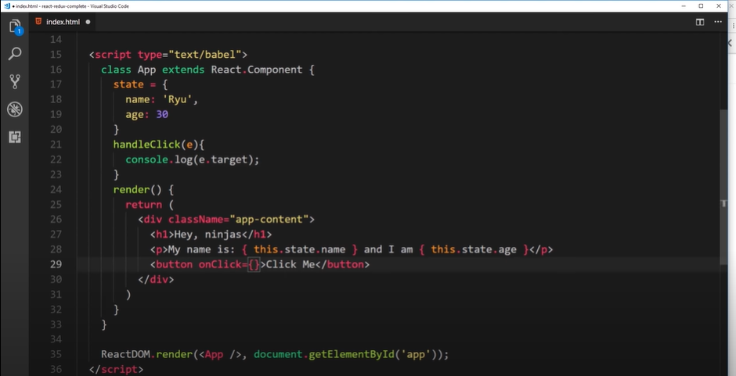

Slide 27
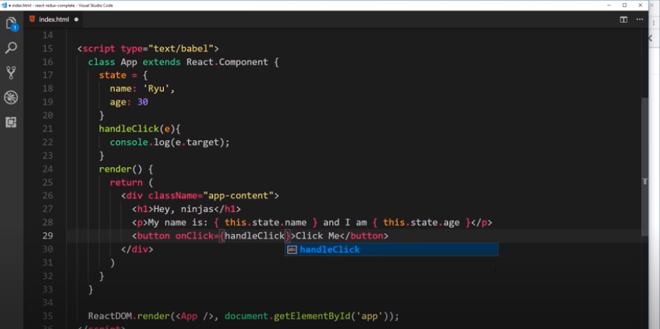
Not like this

Slide 28
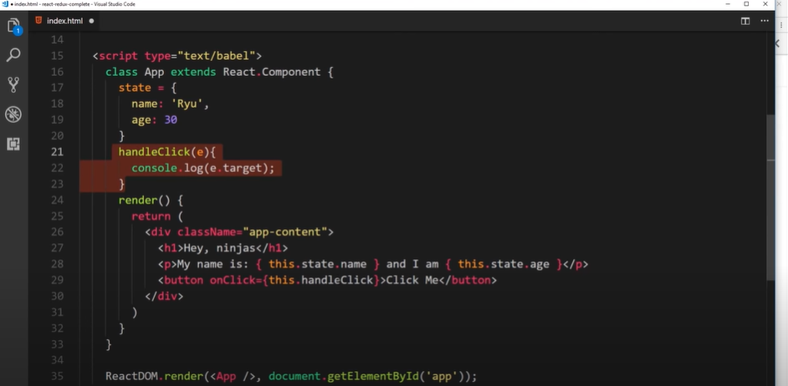

Slide 29
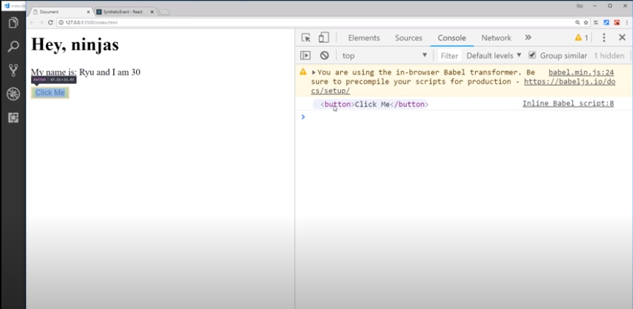

Slide 30
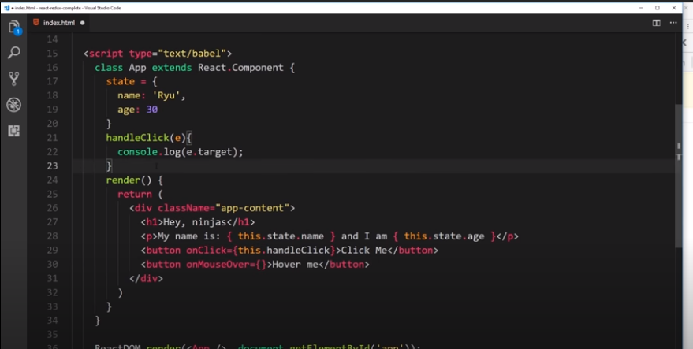
Another Event

Slide 31
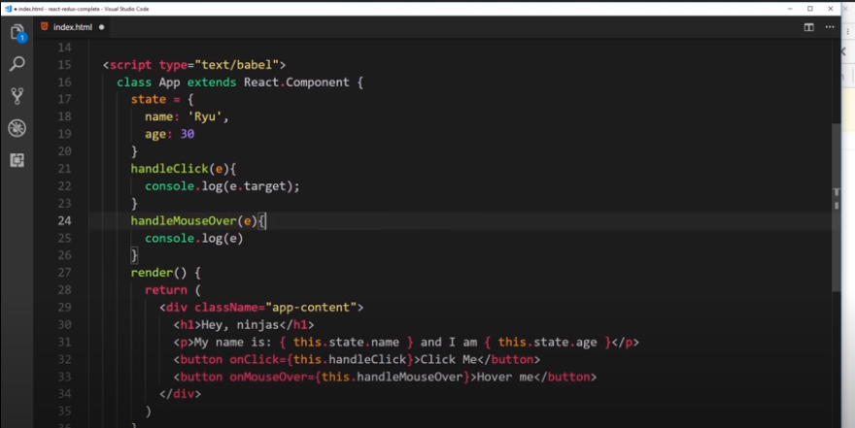

Slide 32
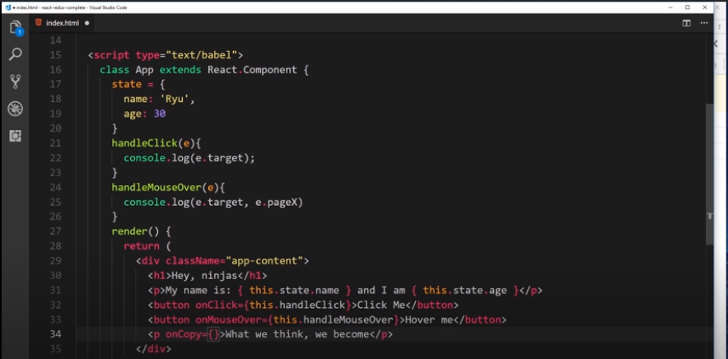

Slide 33
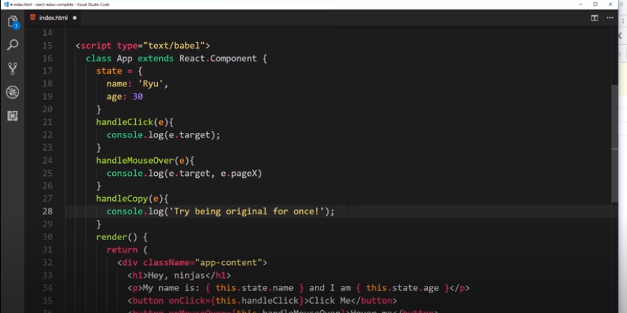

Slide 34
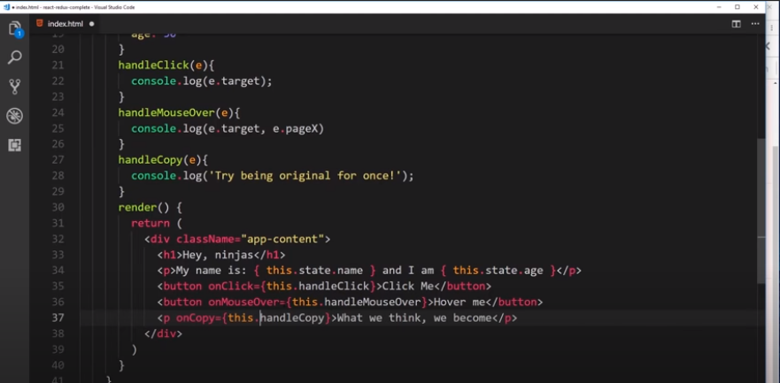

Slide 35
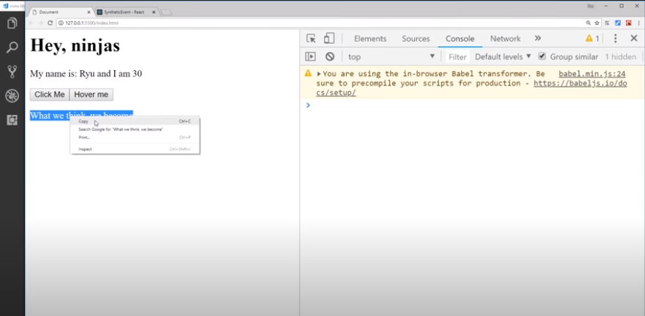

Slide 36
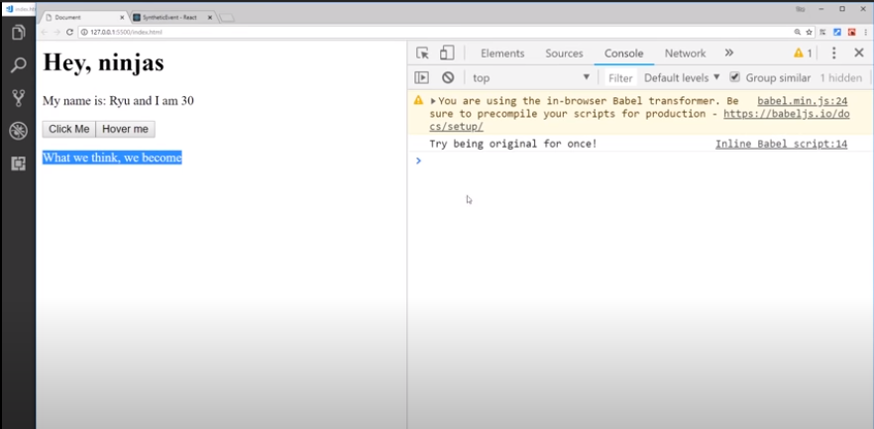

Slide 37
Events in React
https://reactjs.org/docs/events.html#supported-events

Slide 38
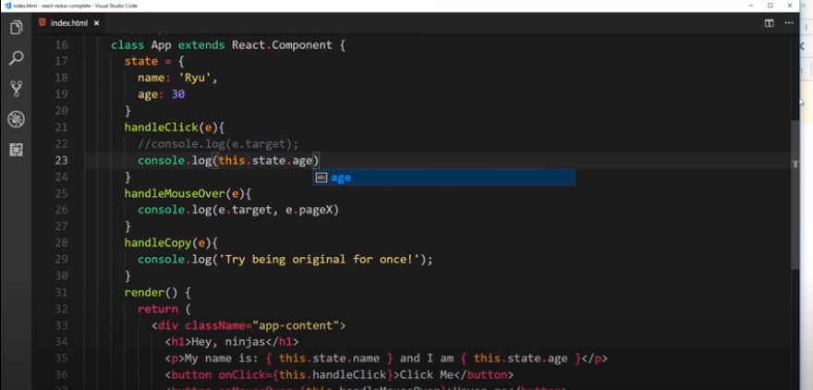
Can we access state like this?

Slide 39
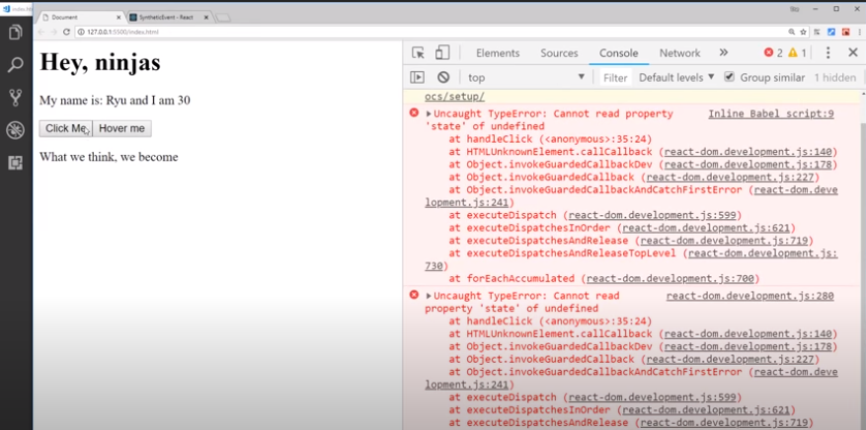

Slide 40
Context of this is loss
In render func React handle it by self
But in our custom functions we have to deal with it manually

Slide 41
Arrow functions

Slide 42
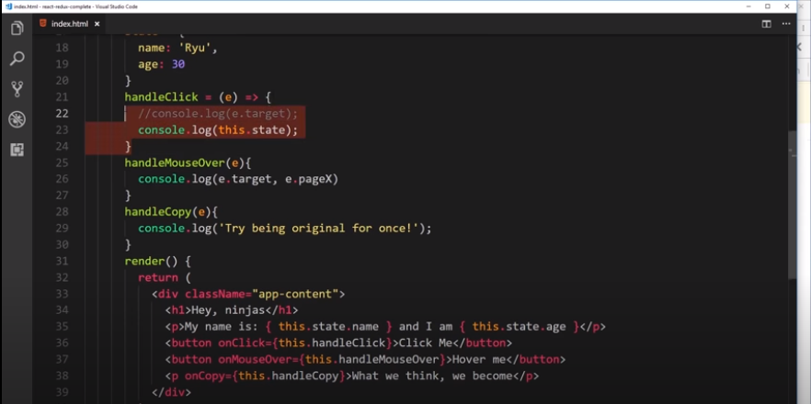

Slide 43
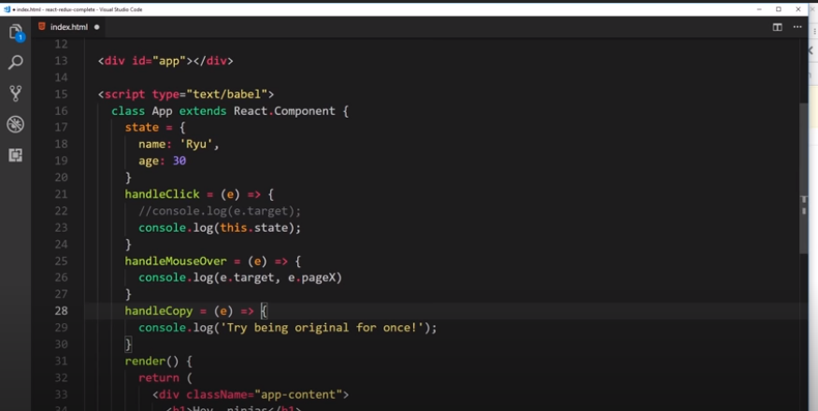

Slide 44
Changing State (and 'this')

Slide 45
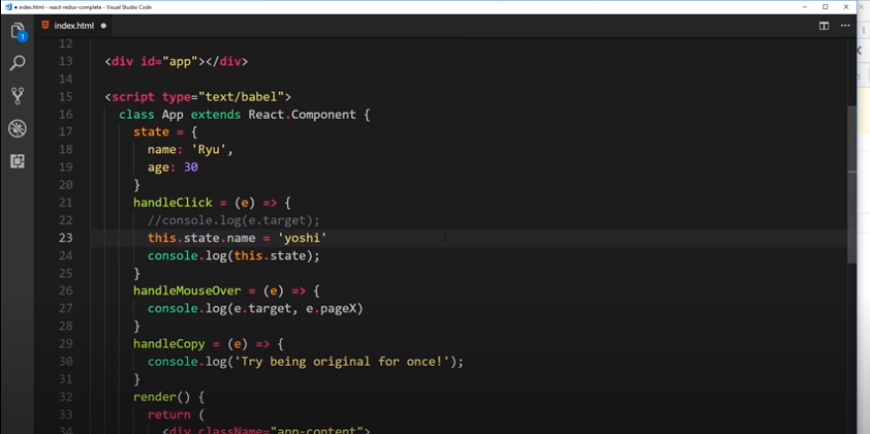
Not a good Practice

Slide 46
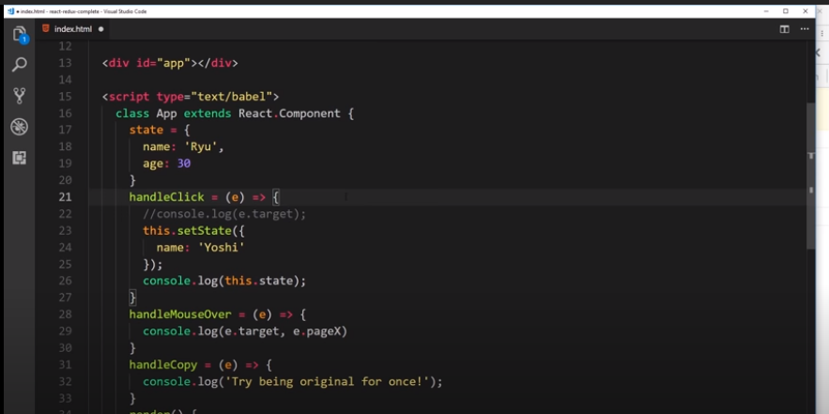

Slide 47
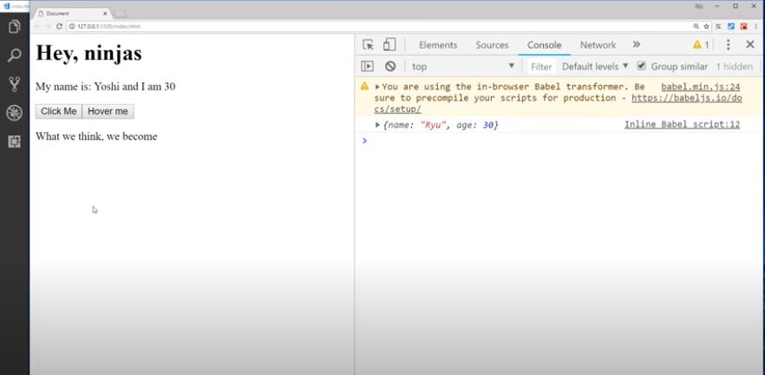

Slide 48
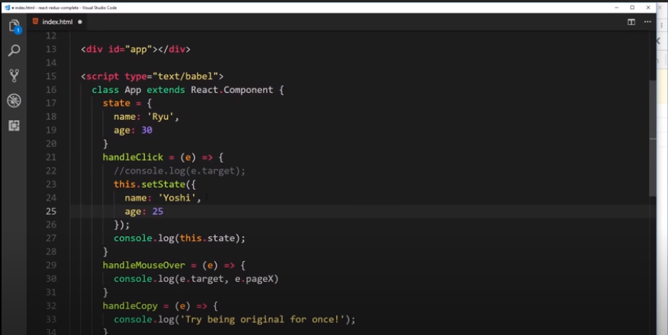

Slide 49


